Slide 1
Canadian Commercial Corporation
The Government of Canada International Contracting and Procurement Agency

Slide 2
Overview
Established in 1946
Export sales agency, a Government of Canada Crown Corporation
  Reports to the Minister for International Trade
The contracts signed in the name of CCC have the same legal effect as those signed in the name of the Government of Canada
Mandated to “assist in the development of trade between Canada and other Nations”

Slide 3
Government and Industry Partners
Canadian Industry
Global Affairs Canada – frontline service and in-country intelligence
  Trade Commissioner Service (TCS), Geographic Desks, Defence and Security Advisory Board, Export Controls
Export Development Canada (EDC)
  export finance and insurance products
Department of National Defence (DND) – entrées into certain markets and opportunities
  joint procurement, international cooperation, military attachés
Public Services and Procurement Canada – support services
  Industrial Security
ISED Canada
  ITB program
Regional Sector Associations

Slide 4


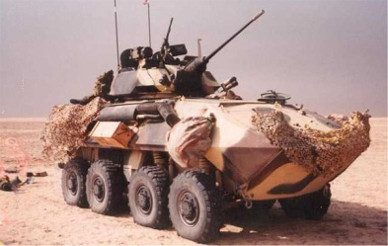

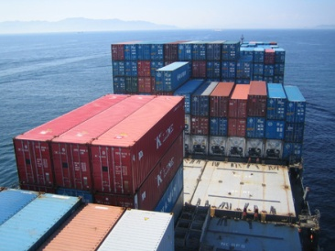



Sector Activity
Aerospace
Education & Health
Defence and Security
Infrastructure
Consumer goods and services
Engineering Services
& Construction
Energy and Power
Transportation
4

Slide 5
Typical Roles
CCC brings international buyers and Canadian exporters together through contracts that offer the best possible terms and conditions
  Prime Contractor to International Buyer
    Guarantee contract performance according to the terms and conditions of the contract
    Contracts with qualified Canadian supplier
  Procurement Service
    Acts as a procurement agent to procure Canadian goods and/or services for foreign buyers and/or OGD’s
    Competitive solicitations for qualified suppliers

Slide 6
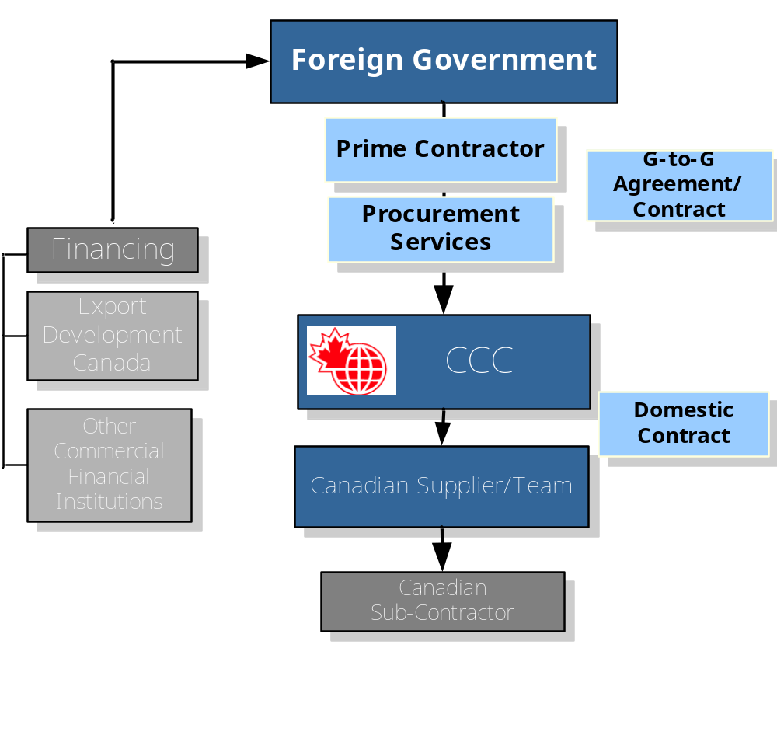
CCC’s Contract Structure

Slide 7
Benefits to
International Buyers
Guarantee of contract performance according to the terms and conditions of the contract
Provides access to Canadian capability
Performs due diligence on the supplier prior to entering into the contract
Offers tailored contracting and procurement solutions to meet the buyer’s requirements

Slide 8
A Strong Canadian Team
CCC – Conducts rigorous assessment of the supplier
  Financially acceptable
  Proven Management capability
  Demonstrated Technical capability for the project
CCC will not sign a contract with a supplier that does not meet our assessment criteria
CCC is flexible on the project team / subcontractor structure
  May include international subcontractors
  May include knowledge / skill transfer to your organization
Buyer financial payment schedule is negotiable
8

Slide 9

P3 Wings with Norway
Bell Helicopters
(The Philippines)
CCC was the prime contractor for the sale of Canadian made Bell helicopters to the Air Force in the Philippines. The contract was completed on schedule and budget.
Find P3 photo
9

Slide 10

Twin Otters
(Peru)
CCC signed a
contract with the
Ministry of Defence
of Peru for the
delivery of 12 Twin
Otter aircraft.
Notes:
Sidney BC

Slide 11
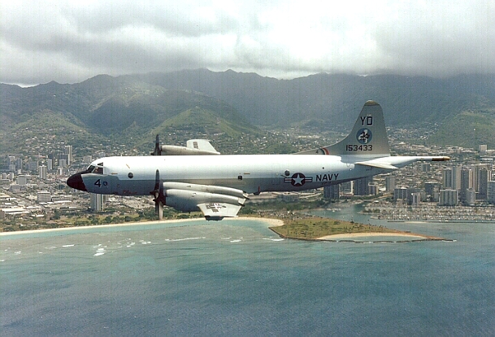
P3 Wings with Norway
Procurement and installation of replacement P3 wings
(Norway)
The Norwegian Air Force approached CCC to develop a procurement strategy and implement the recommendations.
Find P3 photo
11

Slide 12
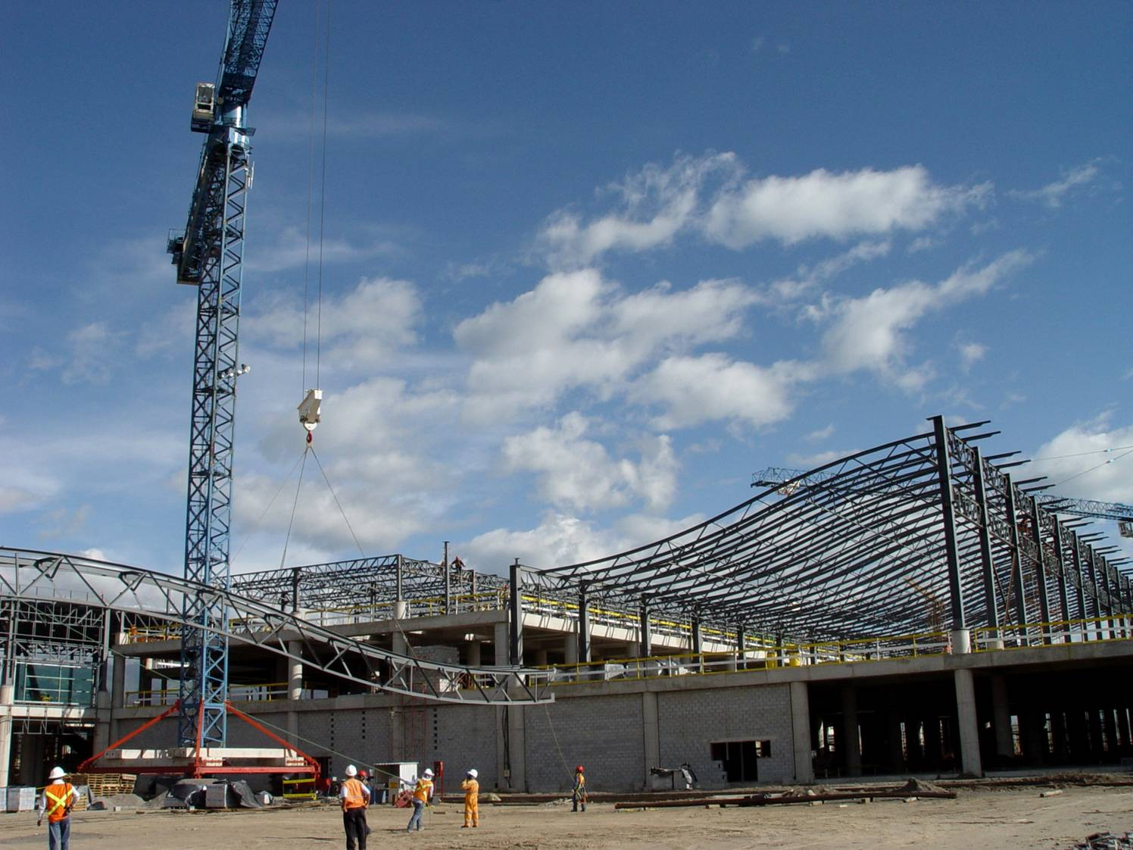
Infrastructure Project (Ecuador)
CCC was the Prime Contractor for the construction of the New International Airport in Quito, Ecuador.
Notes:
12
- CCC worked with Aecon Construction to present a Canadian package to the Quito Airport Authority

Slide 13
Contact Information
50 O’Connor, 11th Floor
Ottawa, Ontario Canada, K1A 0S6
Toll-free in Canada/ 1-800-748-8191
www.ccc.ca
Tom DeWolf
Director, Business Development and Sales
ASIA
tel: (613) 992-3082
E-mail:tdewolf@ccc.ca

